Slide 1
Ocean Acidification

Slide 2
Warm Up
What is ocean acidification and why is it happening?
Ocean acidification is when oceans are becoming more acidic because of too much carbon dioxide dissolved in the ocean.
2. Identify two human actives that contribute to ocean acidification.
Deforestation and fuel emissions from cars, etc.
3. Why are coral reefs important?
¼ of ocean species depend on the coral reefs for food and shelter.

Slide 3
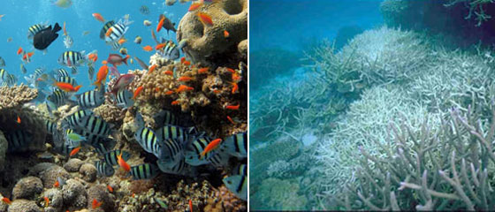
Important Definitions
Ocean Acidification:
When carbon dioxide dissolves in the ocean, and makes the ocean more acidic.

Slide 4
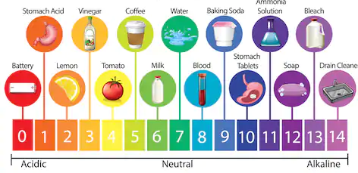
Important Definitions
pH:
A Chemical scale that measures how acidic or how alkaline a substance is.

Slide 5
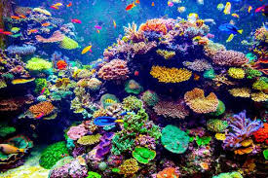
Important Definitions
Coral Reefs:
A coral is a sea animal attached to the ocean floor with a skeleton made of calcium carbonate. Coral reefs are many coral colonies growing together.

Slide 6
LT: I can analyze the effects of ocean acidification on coral reefs by collecting data from a model and drawing conclusions.
Main idea:
To investigate the effects of ocean acidification on coral reefs through a simulation, collect and analyze the data and draw conclusions.
Actionable Steps:
I need to understand what ocean acidification and coral reefs are.
I need to…
I need to…
I need to carry out the simulation and collect data.
I need to analyze the data and draw conclusions.

Slide 7
LT: I can analyze the effects of ocean acidification on coral reefs by collecting data from a model and drawing conclusions.
Activity: Examining the effects of ocean acidification
In this experiment we will examine how acidic conditions affect coral reefs.
We will use chalk make of calcium carbonate in place of the corals, and acetic acid to mimic the acidic conditions in the ocean.

Slide 8
LT: I can analyze the effects of ocean acidification on coral reefs by collecting data from a model and drawing conclusions.
Research question:
What would happen to the biodiversity of coral reefs as the concentration of acid in the ocean increases?
Independent Variable_____________________
Dependent Variable ____________________________
Hypothesis – If… then… because…
Concentration of acid
Biodiversity

Slide 9
LT: I can analyze the effects of ocean acidification on coral reefs by collecting data from a model and drawing conclusions.
Instructions:
Work in pairs
One person from the pair should collect the materials.
Do not start the experiment until you are instructed to.
Listen to directions!

Slide 10
LT: I can analyze the effects of ocean acidification on coral reefs by collecting data from a model and drawing conclusions.
Small group roles:
Facilitator – keep group on track also mindful of time to complete experiment
Time keepers – time the experiment
Materials manager – collect and return the supplies
Content expert – rallies group to answer questions first then ask teachers.

Slide 11
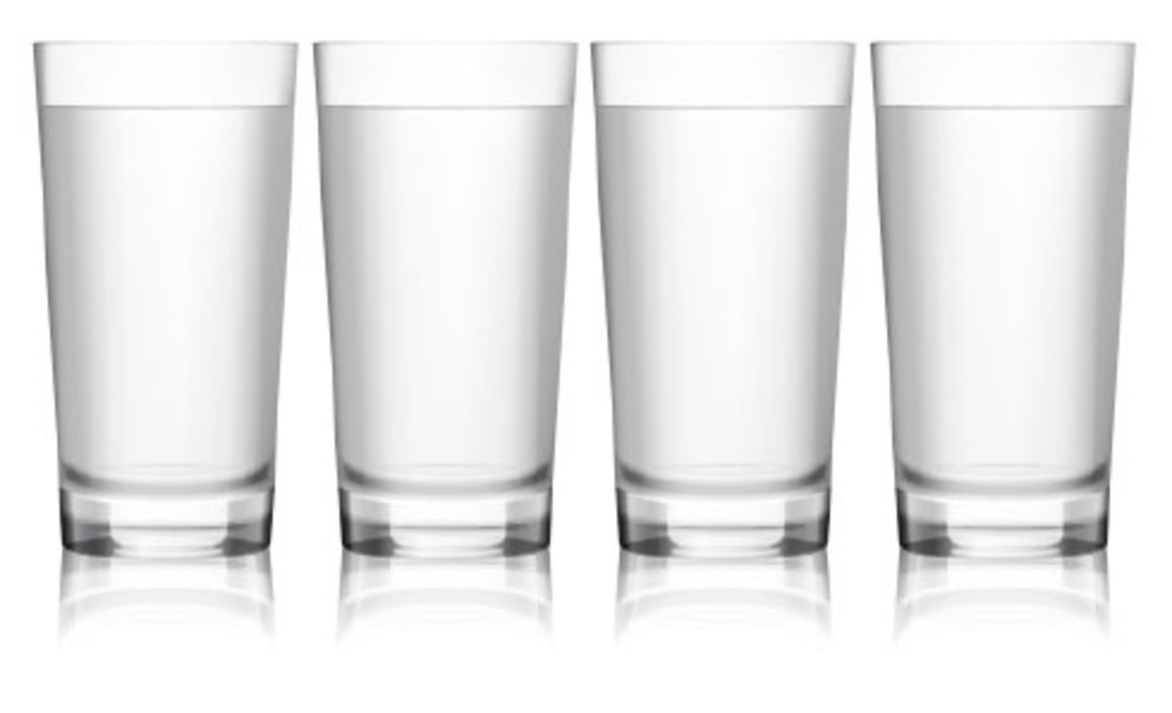


LT: I can analyze the effects of ocean acidification on coral reefs by collecting data from a model and drawing conclusions.
0%
25%
50%
100%

Slide 12
LT: I can analyze the effects of ocean acidification on coral reefs by collecting data from a model and drawing conclusions.
Think about:
What is the control group?
What is the purpose of the 0% acetic acid cup?

Slide 13
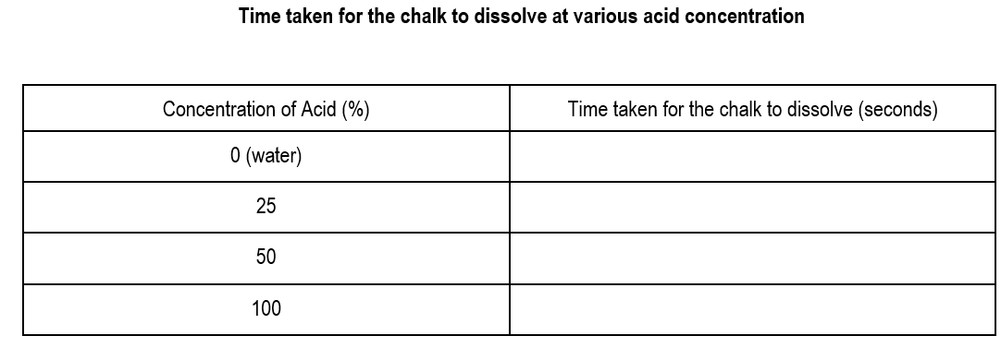
LT: I can analyze the effects of ocean acidification on coral reefs by collecting data from a model and drawing conclusions.
180
145
115
85

Slide 14
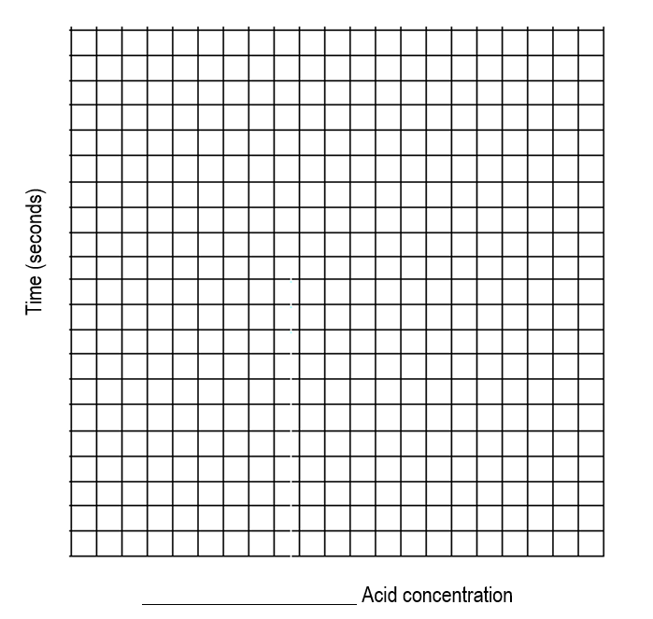
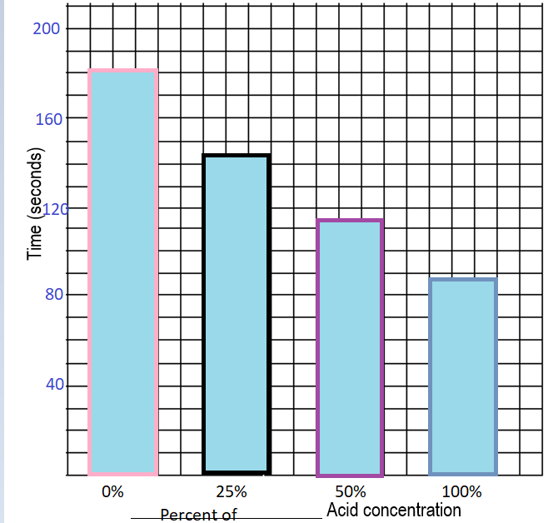
LT: I can analyze the effects of ocean acidification on coral reefs by collecting data from a model and drawing conclusions.

Slide 15
LT: I can analyze the effects of ocean acidification on coral reefs by collecting data from a model and drawing conclusions.

Slide 16
LT: I can analyze the effects of ocean acidification on coral reefs by collecting data from a model and drawing conclusions.
Analysis:
Turn-and-Talk
What is the relationship between the amount of time it takes the chalk to dissolve and the concentration of acid?
As the concentration of acid increase, the amount of
time it takes for the chalk to dissolve decreases.
Notes:
That is the higher the concentration of acid the faster the rate at which the chalk dissolves.

Slide 17
LT: I can analyze the effects of ocean acidification on coral reefs by collecting data from a model and drawing conclusions.
2. What does this relationship tell you about the effect of ocean acidification on the survival of the coral reefs?
3. Based on your experiment with the calcium carbonate chalk and the acetic acid, what do you think will happen to our coral reefs and their biodiversity as the acidity of the ocean increases due to CO₂ emissions?
4. What could humans do to prevent ocean acidification? Hint: Think about activities that are associated with the release of carbon dioxide in to the atmosphere.

Slide 18
LT: I can analyze the effects of ocean acidification on coral reefs by collecting data from a model and drawing conclusions.
Conclusion:
Answer the research question: What would happen to the biodiversity of coral reefs as the concentration of acid in the ocean increases?
Organize your writing using the claim, evidence, concepts and justification format.

