Slide 1
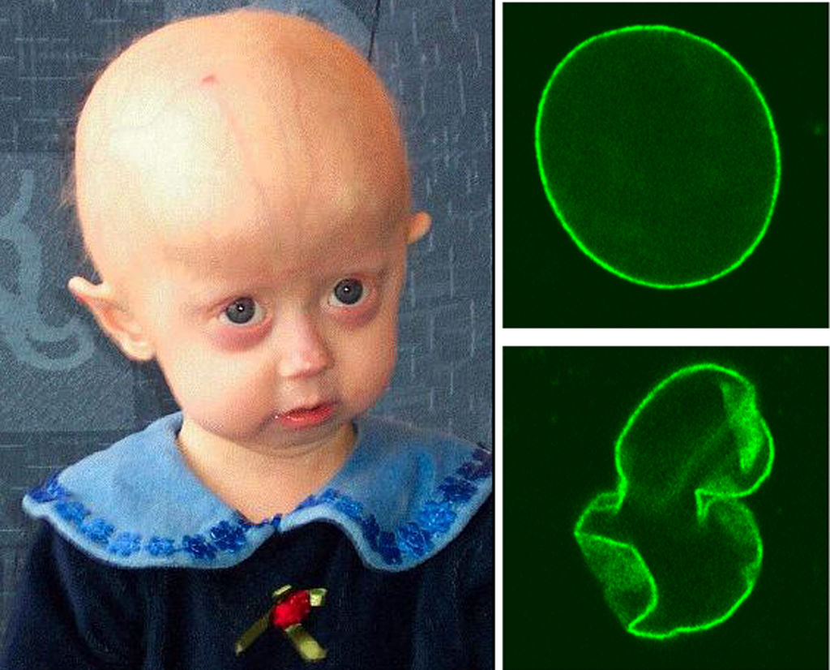
Patient #1: Jackie
Jackie was a healthy baby when she was first born, but after 4 months, she had gained little weight. Her parents suspected something was seriously wrong. Her head became disproportionally large for her face. She experienced hair loss, and her skin became thin and wrinkled. Jackie’s doctors told them that the condition was progeria which occurs when the genetic material doesn’t have proper protection.
This disease is incredibly rare. It
affects only one in every 4-8
million births. It is caused by a
mutation in a gene called LMNA,
but is not hereditary. This disease
causes premature aging. People
with progeria have an average life
expectancy of 14 years and usually
die from heart disease related to
their “aging” body.

Slide 2
Nuclear Envelope
Notes:
Progeria
http://abcnews.go.com/Health/children-living-progeria-inside-world/story?id=14182279

Slide 3
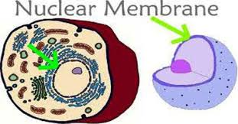
Notes:
Progeria
http://abcnews.go.com/Health/children-living-progeria-inside-world/story?id=14182279

Slide 4

Double-layered membrane that encloses and protects the contents of the nucleus during most of the cell's lifecycle.
Notes:
Progeria
http://abcnews.go.com/Health/children-living-progeria-inside-world/story?id=14182279

Slide 5

Patient #2: Fiona
Fiona is a freshmen in college. She is a good student who does her work on weekdays and likes to party on the weekends with her friends. A few months ago, Fiona developed a cough that wouldn’t to go away and worsened over time. She has also had difficulty breathing over the past week or so. Her friends encouraged her to see the doctor, so she finally made an appointment. The doctor asked her whether or not she smoked cigarettes. Fiona responded that she started smoking cigarettes (about 2 per day) her freshman year of high school.
The doctor decided it was necessary to take a
biopsy of the cells that line the bronchus
(passageway to the lungs). After several days,
the biopsy report has come back along with a
micrograph of the bronchial cells. Fiona's
cigarette smoking has badly damaged these
organelles which are responsible for mucous
and dirt moving up and out of her respiratory
system. What cell organelles have been
damaged?

Slide 6
Cilia
Notes:
Lead to COPD

Slide 7
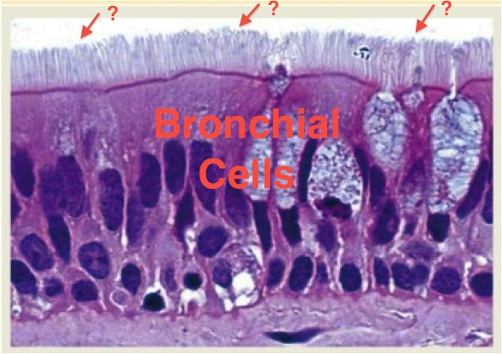
Notes:
Lead to COPD

Slide 8
Small hair-like protuberances on the outside of eukaryotic cells. They are primarily responsible for locomotion, either of the cell itself or of fluids on the cell surface.
Notes:
Lead to COPD

Slide 9
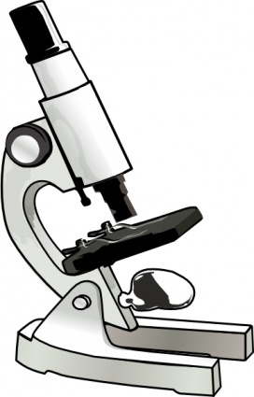
Patients #3: Zeke and Morgan
Zeke and Morgan have lived in Vermont most of their lives. They are both in their late 20's and recently married. They have been trying to have their first child for a number of months but Morgan has been unable to get pregnant. Zeke and Morgan decided to go to their family physician to see if there may be something wrong. The physician
obtained a sample of Zeke's sperm cells
and had it sent to a lab for microscopic
analysis. After several days, the physician
received a micrograph of the sperm cells
and noted a structural defect in the
organelle responsible for cell movement.
Help determine the organelle responsible
for Zeke and Morgan's inability to
have a baby.
Notes:
asthenozoospermia

Slide 10
Flagella

Slide 11
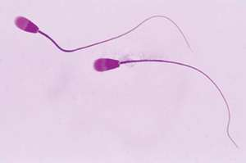

Slide 12
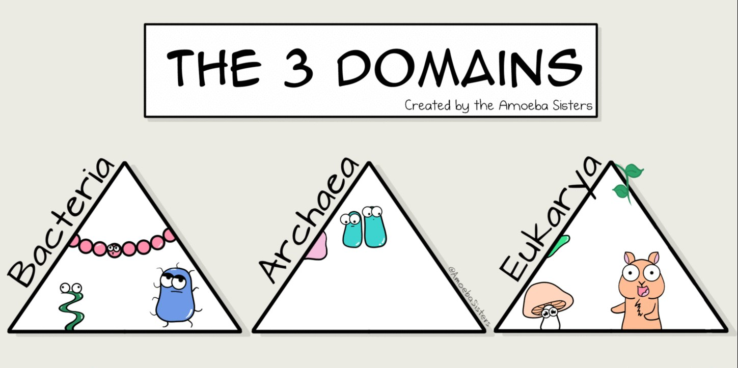
Long, whip-like filamentous protein structures found in bacteria, archaea, and eukaryotes, though they are most commonly found in bacteria. They are typically used to propel a cell through liquid.

Slide 13
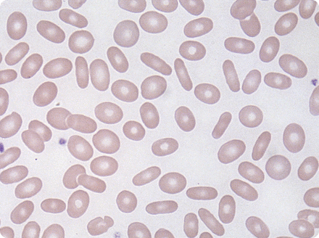
Patient #4: Trevor
Trevor is a 20-year old male who has suffered from repeated episodes of hemolytic anemia. During these episodes, Trevor’s red blood cell counts drop off dramatically due to rupturing of large numbers of cells and the inability of his bone marrow to replace the ruptured cells fast enough. When Trevor comes into a clinic for treatment, he is diagnosed initially with a hereditary deficiency in the enzyme glucose-6-phosphate dehydrogenase, but biochemical tests rule this out. An examination of his blood reveals that many of his red blood cells have an elliptical shape which leads to the
diagnosis of hereditary elliptocytosis. In this disorder,
structures within the red blood cells
alter the shape of the cell from the
normal biconcave, disc shape to an
elliptical shape, causing premature
damage and rupture of the cells.

Slide 14
Cytoskeleton

Slide 15
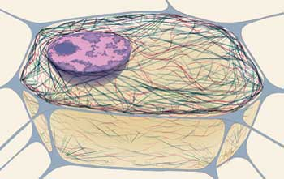

Slide 16
Provides support in a cell. It is a network of protein fibers supporting cell shape and anchoring organelles within the cell.

Slide 17
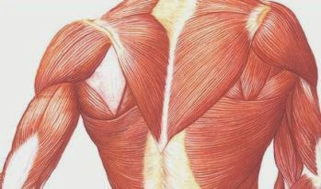
Patient #5: Rosanna
Rosanna is a 39-year old woman who comes to visit an urban New York City clinic. Despite rarely working out, she has a very muscular build, suggesting a hypertrophy (enlargement) of her muscles. She has suffered from bouts of extreme muscle stiffness, especially in her legs, and often brought on by cold weather throughout her life. Her father and paternal grandmother also had these symptoms. After genetic screening and biochemical tests, the doctors determine that she is suffering from myotonia congenita, a
“channelopathy” involving a
malfunction of chloride
channels, which regulate the
movement of chloride ions
between the outside and
inside of the cell.

Slide 18
Plasma
Membrane

Slide 19
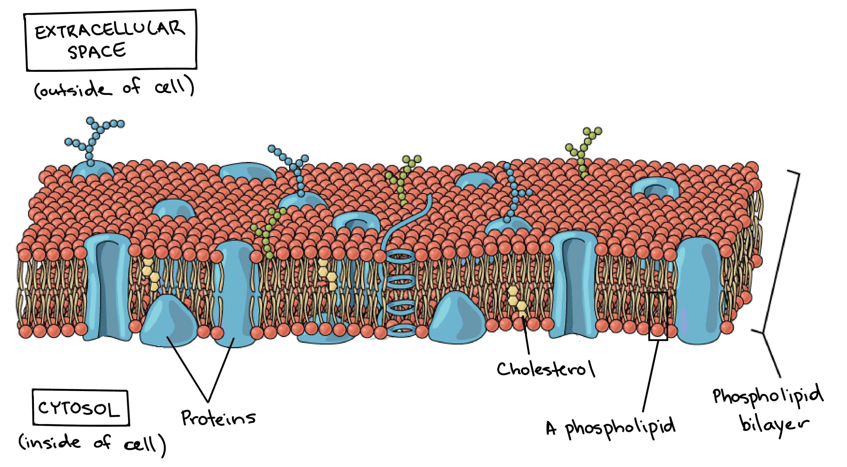

Slide 20

The border between the interior and exterior of a cell. It controls passage of various molecules—including sugars, amino acids, ions, and water—into and out of the cell.

Slide 21

Patient #6: Harvey
Harvey was a perfectly happy baby with normal development until about six months of age. He had learned to roll over and sit up for a few seconds, but then was suddenly unable to do either of these things. He stopped turning and smiling at his mother's voice as he had before, and he did not seem as interested in his toys as he once was. Harvey’s parents took him to the doctor because they were concerned about these changes. It took exams by several specialists to diagnose Harvey's Tay-Sachs disease. This disease has become very rare (fewer than ten cases appear each year) in large part due to screening programs in population groups known to have this inherited illness. Harvey's parents were not among those ethnic groups most as risk. Also, they had no idea that they both were carriers of the gene that causes this very rare illness. A neurologist verified her hypothesis of Tay-Sachs by looking into Harvey's eyes, where she saw the telltale cherry red spot indicating the illness. There was a build up fatty material on his nerve cells that his cells couldn’t break down. His nervous system would continue
to fail, and he would be
paralyzed and unable to see or
hear by the time he died
before the age of four.
Notes:
Lysosomes Tay Sachs

Slide 22
Lysosomes

Slide 23
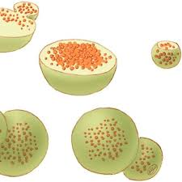

Slide 24
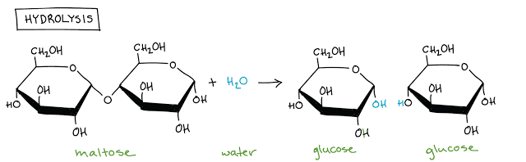
A vesicle that contains hydrolytic enzymes that can break down many kinds of biomolecules.

Slide 25
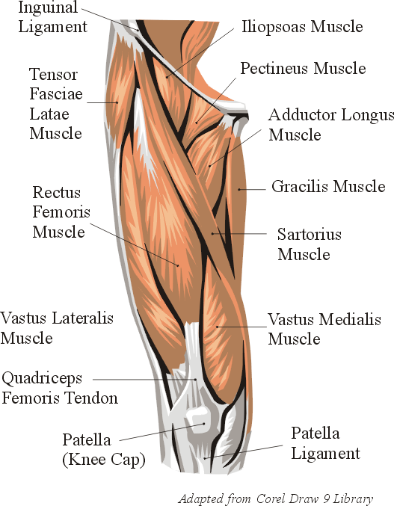
Patient #7: Kathy
Kathy is a fifteen-year-old soccer player at a nearby high school. She arrived in the ER at 6:07 p.m. She was experiencing extreme muscle weakness and loss of muscle coordination, particularly in her arms and legs! She told the doctors that for the past few days, she had been extra tired with little energy to do anything. The doctors decided to do some blood work which showed one particular abnormality. Kathy’s glucose levels were rather high although she was an athlete and did mention she usually ate carbohydrates the night before a game. However, this explanation could be dismissed since she did not have a game in the past week. The doctors agreed that
something else must be going on to cause such high
glucose levels (i.e. something was not breaking down these
sugar molecules). The doctors ordered for a muscle
biopsy to be performed. The doctors viewed the
tissue sample under the microscope, and saw that
the muscle fibers were ragged red which contained
mild accumulations of glycogen and decreased
activity for the enzyme cytochrome c oxidase.

Slide 26
Mitochondria
Notes:
MERRF

Slide 27
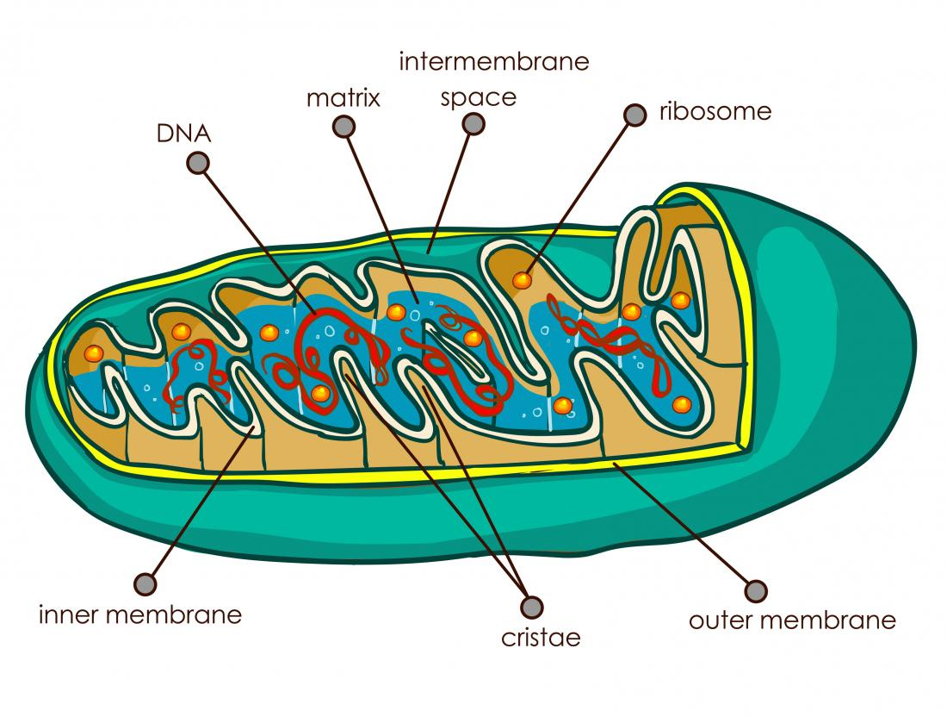
Notes:
MERRF

Slide 28
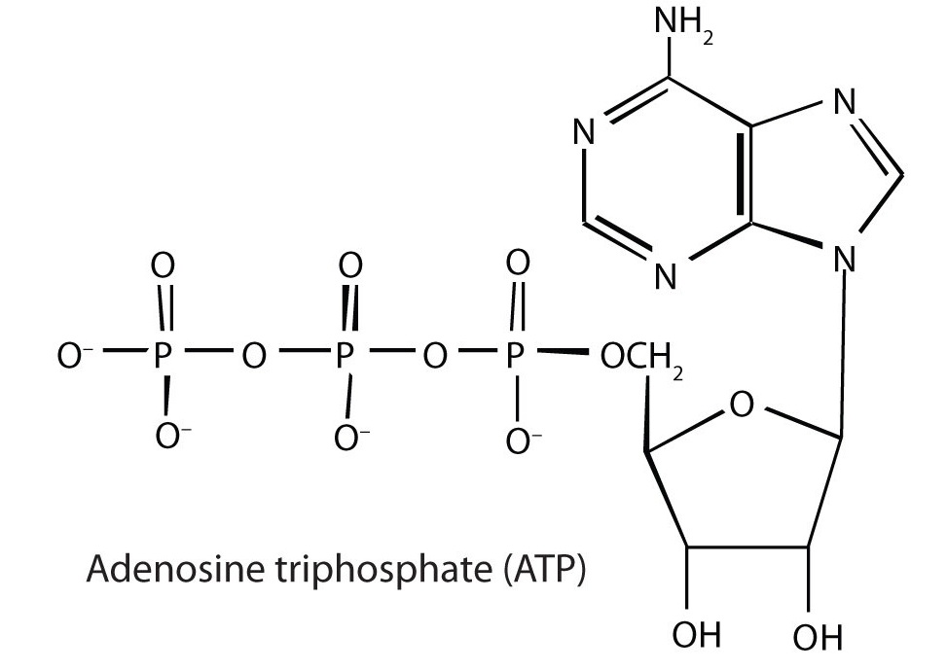
Rod-shaped organelles that can be considered the power generators of the cell, converting oxygen and nutrients into adenosine triphosphate (ATP)
Notes:
MERRF

Slide 29
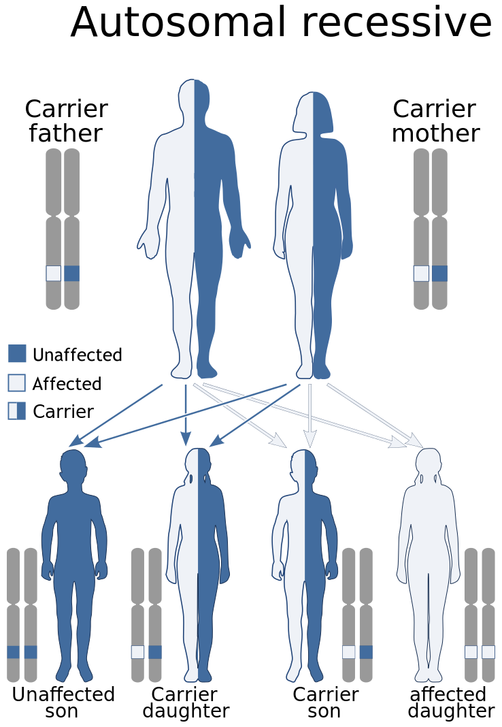
Patient #8: Lucy and Jim
Lucy and Jim have been married for 5 years and have decided they would like to try to have a child. However, a rare genetic disorder runs in both or their families, so they decide to go to a genetic counselor to determine the chances that their future child will be affected. The disease achondrogenesis 1a affects the ability of proteins necessary for bone and cartilage development to be modified and packaged properly after
leaving the endoplasmic reticulum. The
results are devastating. Individuals with this
disorder are often stillborn or die soon after
birth from respiratory failure. Fortunately,
after doing a genetic screening, the genetic
counselor determined that while Jim is a
carrier for this autosomal recessive disorder,
Lucy is not. Therefore, if they do have a child,
it is unlikely that their child will be affected.

Slide 30
Golgi
Apparatus

Slide 31
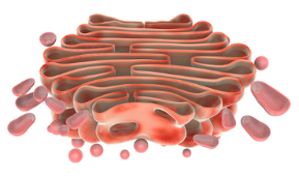

Slide 32

Gathers simple molecules and combines them to make molecules that are more complex. It then takes those big molecules, packages them in vesicles, and either stores them for later use or sends them out of the cell. It is also the
organelle that builds
lysosomes.

Slide 33
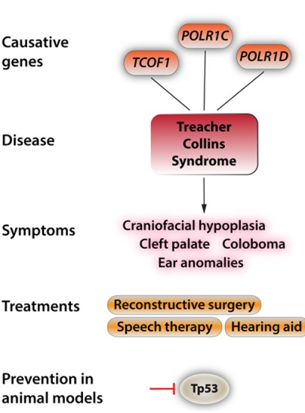
Patient #9: Vera
When Vera came home from her first day of kindergarten, she was very upset. She always knew she was different, but she had never been around this many new people who were staring and whispering. Vera was born with Treacher Collins syndrome. She has it because there is a mutation in her DNA that codes for the part of the cell responsible for assembling
proteins. Because these cells are unable to
make proteins, they undergo apoptosis
(programmed cell death). Doctors don’t
know why but this cell death occurs only in
the cells necessary for the development of
facial bones and tissues. Even though Vera
has had several plastic surgeries in her life
to make her appearance less affected by
the disease, she continues to have distinct
facial characteristics, such as
underdeveloped cheek bones, unusually
formed ears, and a very small jaw and chin.

Slide 34
Ribosomes

Slide 35
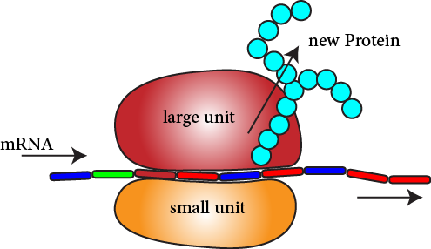

Slide 36
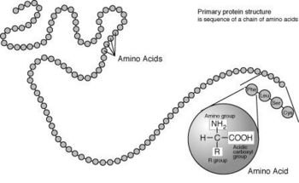
Link amino acids together in the order designated by the mRNA to create proteins, can be found floating free in the cytoplasm or attached the endoplasmic reticulum.

Slide 37
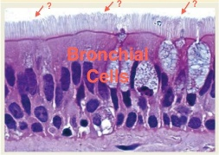
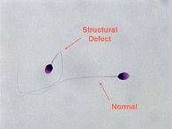
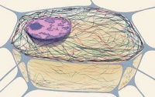
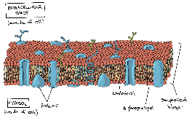
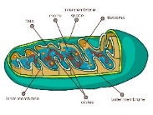
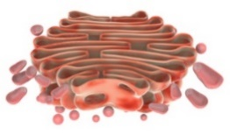

Name of Organelle | Picture | Function | Patient/Disease
Nuclear Envelope |  | Double-layered membrane that encloses and protects the contents of the nucleus during most of the cell’s lifecycle | Patient #1 Jackie Progeria
Cilia |  | Small hair-like protuberances on the outside of eukaryotic cells. They are primarily responsible for locomotion, either on the cell itself or of fluids on the cell surface | Patient #2 Fiona Cough from smoking/COPD
Flagella |  | Long, whip-like filamentous protein structures found in bacteria, archaea, and eukaryotes, though they are typically used to propel a cell through liquid | Patient #3 Zeke and Morgan Infertility/MMF
Cytoskeleton |  | Provides support in a cell. It is a network of protein fibers supporting cell shape and anchoring organelles within the cell. | Patient #4 Trevor Hereditary Elliptocytosis
Plasma Membrane |  | The border between the interior and exterior of a cell. It controls passage of various molecules – including sugars, amino acids, ions, and water – into and out of the cell | Patient #5 Rosanna Myotonia Congenita
Lysosome |  | A vesicle that contains hydrolytic enzymes that can break down many kinds of biomolecules | Patient #6 Harvey Tay-Sachs
Mitochondria |  | Rod-shaped organelles that can be considered the power generators of the cell, converting oxygen and nutrients into adenosine triphosphate (ATP) | Patient #7 Kathy Decreased Cytochrome C Oxidase/Myopathy
Golgi |  | Gathers simple molecules and combines them to make molecules that are more complex. It then takes those big molecules, packages them in vesicles, and either stores them for later use or sends them out of the cell. It is also the organelle that builds the lysosomes. | Patient #8 Jim and Lucy Achondrogenesis 1a
Ribosomes |  | Link amino acids together in the order designated by the mRNA to create proteins, can be found floating free in the cytoplasm or attached to the endoplasmic reticulum. | Patient #9 Vera Treacher Collins

