Slide 1









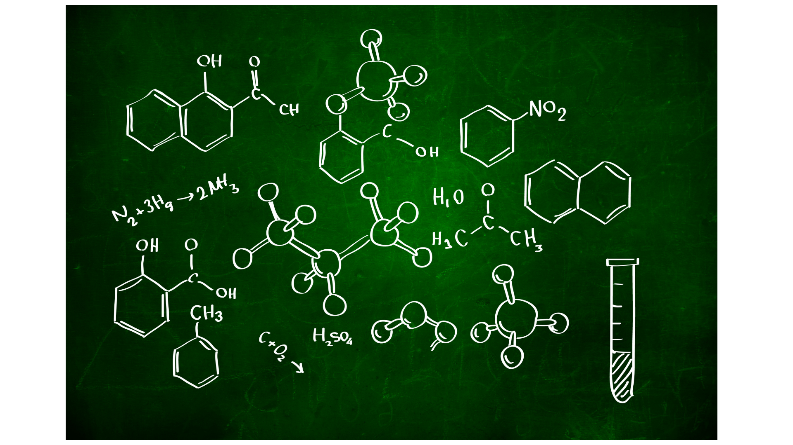



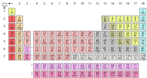









Catalyst Question:
Imagine that you work at a bakery and you have to make 45 moles of cookies. Given the chemical equation below, how many moles of chocolate chips do you need?
5 Chocolate Chips + 2 Butter → 1 Cookie
Meet the world’s Finest Chemists
Start typing your answer into the chat box, but do not post until I say so.

Slide 2



Agenda
Upcoming Important Dates:
Refresher: Mole Ratio
Discussion: Balloon Demonstration
Investigate: Google Slides Particulate Diagram
Reflect: Math Mistakes
Start HW: 5.2 HW Two Step Problems
Homework Review!
This Week… Molar mass conversions, mole ratio, stoichiometry, balloon demonstration, multi step conversions

Slide 3
Agenda
Upcoming Important Dates:
Objectives:
Describe the purpose of stoichiometry and conversions.
Explain the connection between particle diagrams and stoichiometry.
Describe the relationship between mole ratio and the coefficients present in a chemical reaction.
Represent how coefficients are connected to the amount of reactants available through analysis of a particle diagram.
Analyze two step stoichiometry problems for potential math mistakes and recognize common errors.
Standard:
HS-PS1-7: Use mathematical representations to support the claim that atoms, and therefore mass, are conserved during a chemical reaction.

Slide 4





Transition Practice: Listening → Note Taking
Sounds like?
No Voices, No Phones
Wait for teacher instructions!
NO CHAT BOX
Looks like?
All students are in their seats.
Pencil/Pen in hand.
Reading and writing ONLY what is important from the slide!

Slide 5


Slide 6

Refresher!
What is a mole?
A unit of measurement that describes the amount of a compound
Recipe:
340 g of Flour
150 g of sugar
4.2 g baking soda
57 g of vanilla
227 grams of butter
5.7 g salt
2 eggs (~114 g)
340 g chocolate chips
2.66 mol C₄H₈O₅
0.31 mol C₁₂H₂₂O₁₁
0.0335 mol NaHCO₃
0.062 mol C₈H₈O₃
1.084 mol C₉H₁₄O₆
0.036 mol NaCl
0.624 mol C₆H₁₂O₃N₂
2.82 mol C₄H₈O₄
Notes:
Reiterate to students how moles and weight of a substance is different

Slide 7
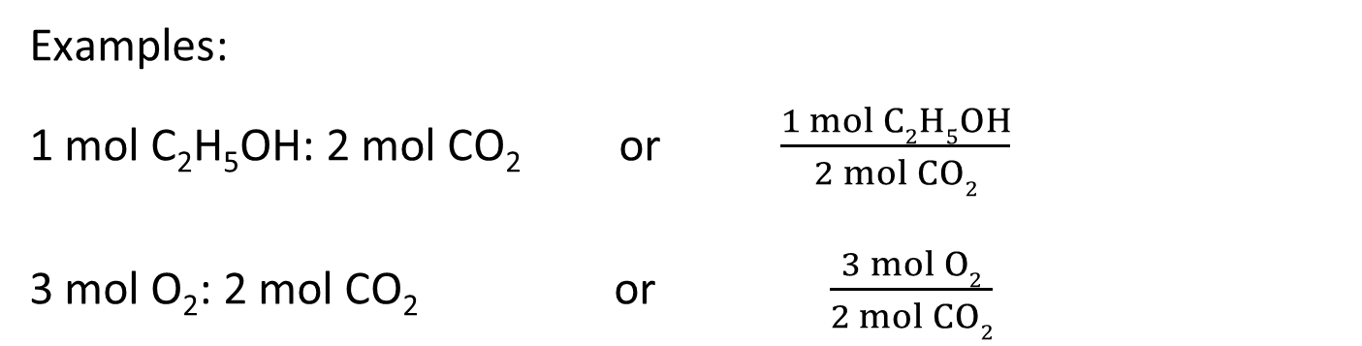
What is a mole ratio?
A mole ratio is a ratio between the number of moles of any two substances in a balanced chemical equation.
Mole ratios are written as ratios or fractions.
C₂H₅OH + 3O₂ → 2CO₂ + 3H₂O
Examples:
1 mol C₂H₅OH: 2 mol CO₂ or $\frac{1 mol C2H5OH}{2 mol CO2}$
3 mol O₂: 2 mol CO₂ or $\frac{3 mol O2}{2 mol CO2}$

Slide 8
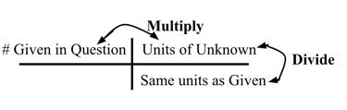
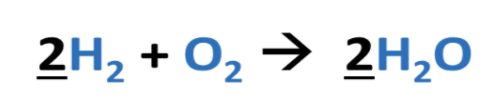
Guided Practice…
Mole B → Mole A
Hydrogen gas reacts with oxygen to produce water in the equation below. Assuming H₂ is the limiting reagent, how many moles of H₂O will be produced from the reaction using 5.0 moles of hydrogen gas?
5 moles H₂
2 moles H₂O
= 5 moles H₂O
2 moles H₂

Slide 9

Independent Practice…
Mole B → Mole A
Propane (C₃H₈) burns in oxygen according to the equation below. How many moles of CO₂ will be produced from the reaction using 12.0 moles of propane?
→ Start typing the answer to one question in the chat box but do NOT post it until I say to!
12 moles C₃H₈
3 moles CO₂
= 36 moles CO₂
1 moles C₃H₈

Slide 10

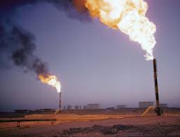


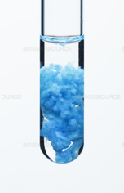

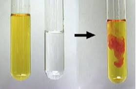
Transition to Lab Demonstration!
Possible Observations:
Color changes
Smells or odor
Changes in temperature
Bubbles
Formation of gas
Formation of solid
As the teacher does the demonstration type notices/wonders in the chat!
I observed…
I noticed…
This reminds me of…
I wonder why...

Slide 11

Teacher Led - Discussion
Questions:
What did you observe during the demonstration?
Why do you think the balloons are different sizes?
How does this experiment relate to the conservation of mass and what we’ve learned about moles?
How to Participate?
Raise your hand or post in chat:
  To provide an answer!
  To respond to a classmate’s comment!
Use the sentence stems:
I observed____.
This reminds me of____ because____.
I wonder why____.
Final Argument: I think the balloons are different sizes because...
Notes:
Notes: Make list on board as students volunteer answers!

Slide 12








1
2
3
4
5
6
7
Mid-class Check in Question: Which David (from Schitt’s Creek) represents your feelings about mole ratio/demo? How ya feeling?
→ Type a number answer to the question in the chat box.

Slide 13

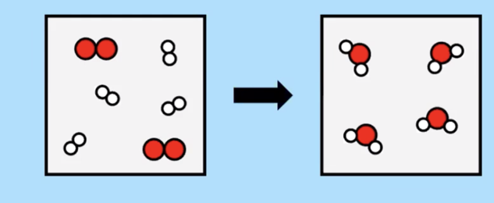



How do we represent reactions?
Balanced chemical equations in their various forms can be translated into symbolic particulate representations.
1
Key
O₂
H₂

Slide 14

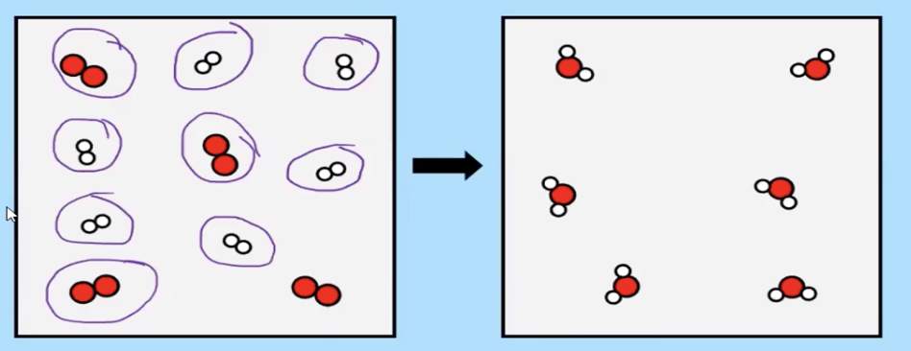
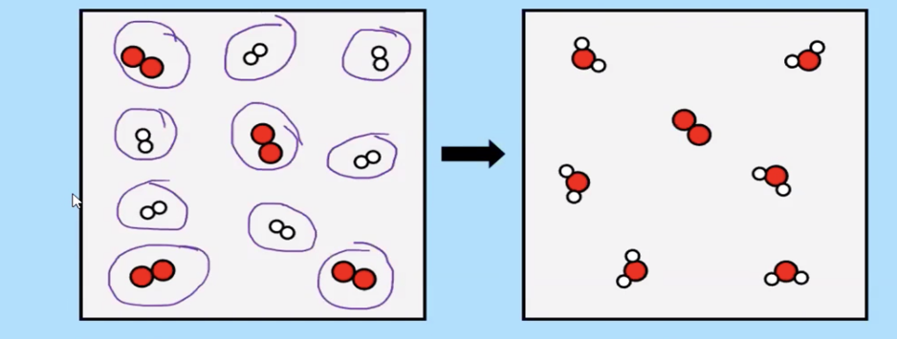
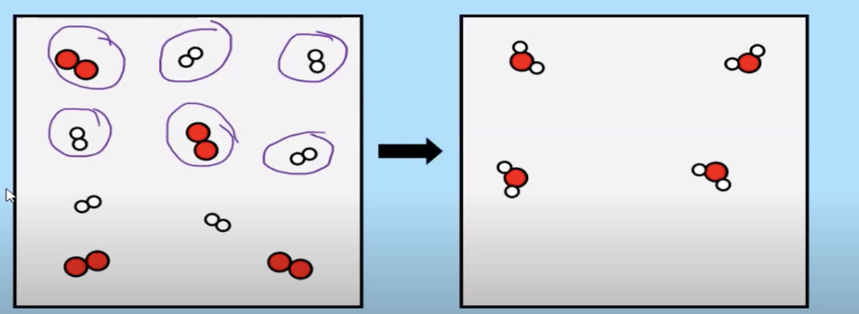
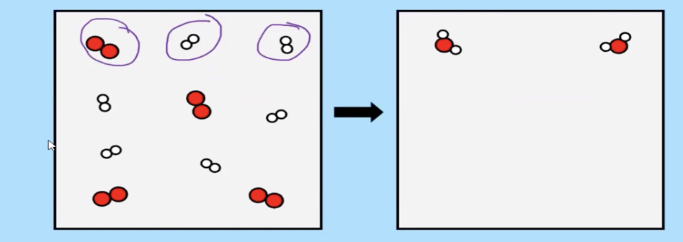
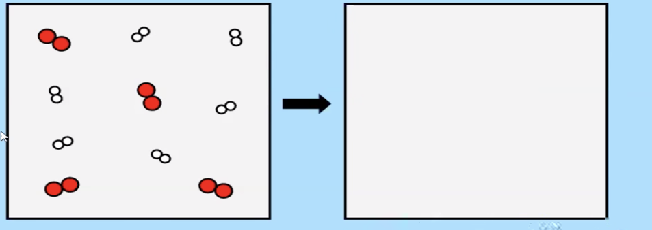

Particle Diagrams (continued)
We can also use them to determine how much product we will make as well!
Key
O₂
H₂

Slide 15
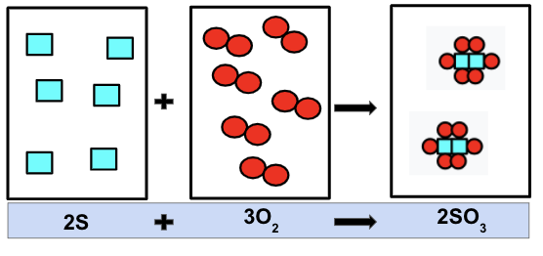
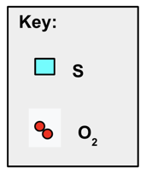
Investigate Particle Diagrams
Group Work Expectations:
Communicate with members about your technology
Be present on the slides
Ask questions in chat or on slides!
Light Blue Box: recipe or chemical equation that you must follow.
Black Boxes: represent the amount of reactants that you actually have or how many ingredients you have in the kitchen?
Goal: Is the product black box correct?
Type questions for your peers in the chat!

Slide 16
2nd Block Groups
Google Slides Link!
Group 1
Slide 5
Group 2
Slide 6
Group 3
Slide 7
Group 4
Slide 8
Group 5
Slide 9

Slide 17
3rd Block Groups
Google Slides Link!
Group 1
Slide 5
Group 2
Slide 6
Group 3
Slide 7
Group 4
Slide 8
Group 5
Slide 9

Slide 18
Teacher Led - Discussion
Question:
What should the correct particle diagram look like in the product? Why?
Was there any leftover material?
If so, then what is the limiting reagent?
How to Participate?
Raise your hand or post in chat:
  To provide an answer!
  To respond to a classmate’s comment!
Use the sentence stems:
Final Argument: I think the correct particle diagram should include...
Notes:
Notes: Make list on board as students volunteer answers!

Slide 19
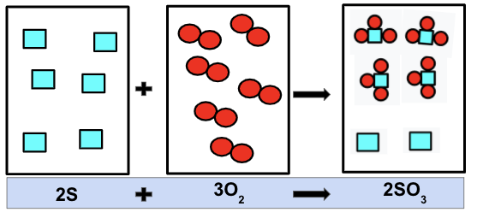
Teacher Led - Discussion
Question:
What should the correct particle diagram look like in the product? Why?
Was there any leftover material?
If so, then what is the limiting reagent?
How to Participate?
Raise your hand or post in chat:
  To provide an answer!
  To respond to a classmate’s comment!
Use the sentence stems:
Final Argument: I think the correct particle diagram should include...
Notes:
Notes: Make list on board as students volunteer answers!

Slide 20
Reflect: Common Math Mistakes
mole A mole B
Analyze the answer to the question given the equation:
4Na + O₂ → 2Na₂O
How many moles of sodium oxide, Na₂O, will form if one uses 5.5 moles of O₂ ?
5.5 moles O₂
5.5 moles O₂
2 moles Na₂O
1 mole O₂
= 0 moles Na₂O
= 2.75 moles Na₂O
0 moles O₂
2 moles Na₂O
Type answer in chat: Do you agree or disagree with the answer? Why or why not?

Slide 21
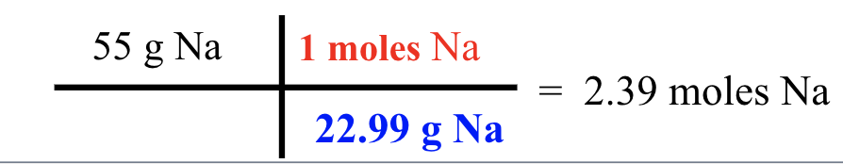
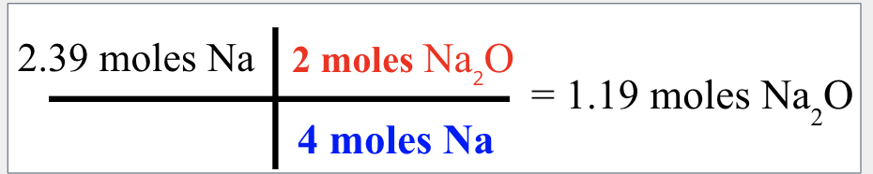
mole A grams(mass) B
mole A mole B
Analyze the answer to the question given the equation:
4Na + O₂ → 2Na₂O
2. How many moles of sodium oxide, Na₂O, will form if one uses 55 g of Na?
55 g Na
2 moles Na₂O
= 27.5 moles Na₂O
4 moles Na
Type answer in chat: Do you agree or disagree with the answer? Why or why not?

Slide 22
Start HW Worksheet (Two Step Problems)
Location:
Use the online calculator!
Models and screen shares question 1 & 3.
Show all work and include units!
Type or handwrite for submissions!

Slide 23

QUESTIONS & ANSWERS

Slide 24

Homework?
Upcoming Important Dates:
Due Date:
Tasks:
Reminder:

