Slide 1
Moon Landing challenge

Slide 2
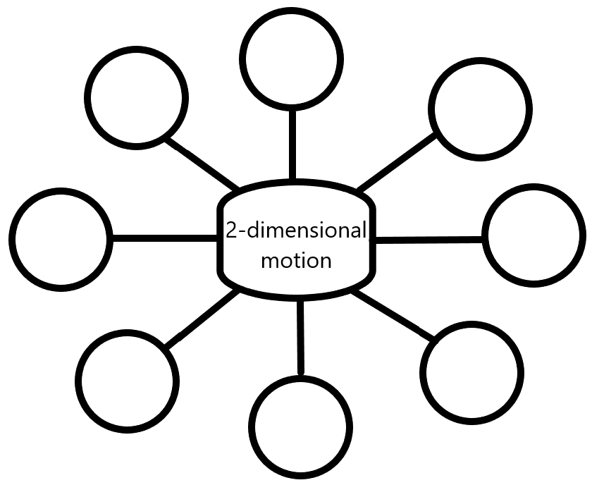
2-D Motion Concept Map

Slide 3
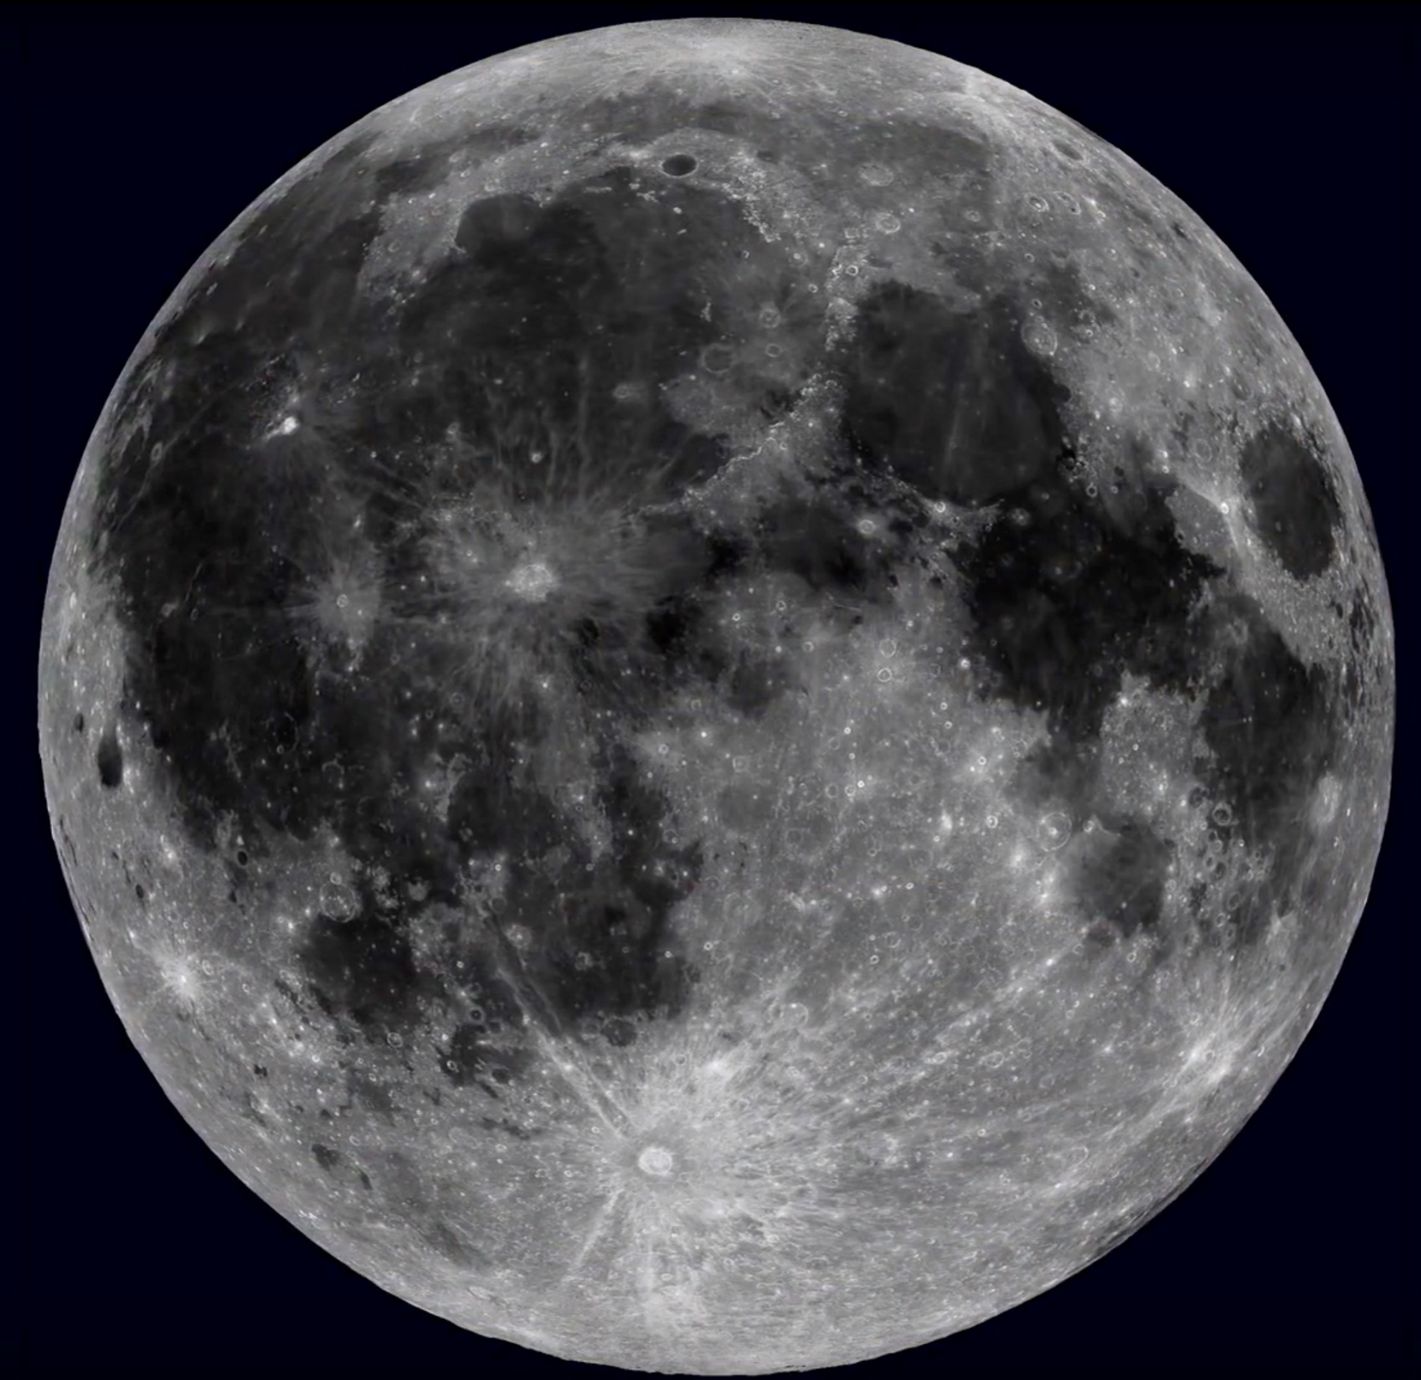
What do you know about the moon?

Slide 4
https://youtu.be/_T8cn2J13-4

Slide 5
Artemis
Why Artemis?
Why the lunar surface?

Slide 6
Lunar Gateway – Human Landing System
How does the HLS relate to what we have been talking about in 2-dimensional motion?

Slide 7
The Challenge
Thinking about The Gateway with the HLS delivery mechanism and your understanding of 2-dimensional motion, design a system using commonly-found materials to land an object on a target.
https://www.youtube.com/watch?v=d_xSgtDkmk8

Slide 8
Objectives
Students will engage in the engineering process of building a landing system out of found materials to land an object on a target.
Students will analyze the trajectory of the object to describe its motion utilizing the principles of 2-dimensional motion.
Students will communicate their design, process, and results in a presentation format.

Slide 9
Moon Landing Challenge
Challenge: Modify a paper cup to release an object onto a target as it travels down a zip line.
Consider the following:
How will you modify the cup to carry a marble and drop it onto its target?
How will you remotely release the marble?
When do you need to launch the marble to hit the target?
Requirements:
Complete an engineering notebook to track your progress (see “Engineering Notebook” for requirements).
Zip line is 1.8 meters in length, stretched taut.
One end of the zip line is 0.5 meters higher than the other.
Target is 0.25 meters by 0.25 meters, with the center of the target located 0.75 meters from the lowest end of the zip line.

Slide 10
Moon Landing Challenge

Slide 11
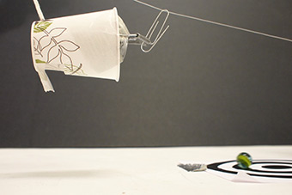
Moon Landing Challenge
Materials Needed:
Camera (phone works fine)
Calculator
Notebook/paper
Paper cup
Smooth string/fishing line (at least 3 meters)
Small round object (marble, bouncy ball, paper, etc.)
Tape
Ruler
Paper clips
Index cards
Scissors
At least two chairs/items to tie string to
Any other found items that may be useful in design
Image courtesy of https://pbskids.org/designsquad /build/target/

Slide 12
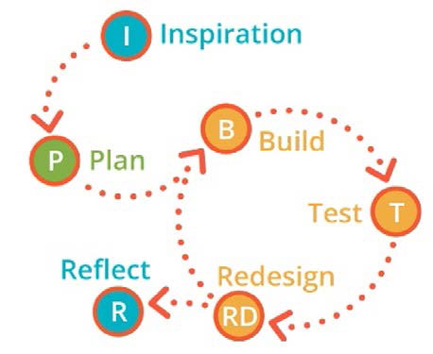
Moon Landing Challenge
Process:
Brainstorm/design your delivery system.
Build your delivery system.
Test your delivery system.
Evaluate its performance.
Redesign the system as needed to obtain the desired result.
Complete a report discussing your design, process, results, and big takeaways.

Slide 13
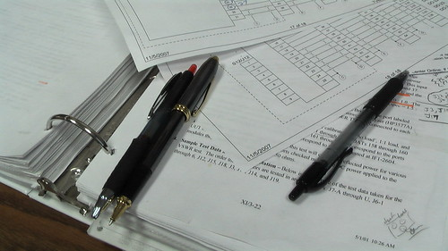
Engineering Notebook
Explain design of delivery system, including any and all changes made to the prototype.
Include specifics on the measurements of each object used, amount of items, release system timing, etc.
Include results from each experiment of prototypes.
Record measurements of where on zip line it was released, where it landed relative to its release, and the distance from the target upon landing.

Slide 14
Moon Landing Report
Include the following:
Your Engineering Notebook:
Design process, detailing initial design to final design
The reasoning behind any changes made from the initial prototype
Photo/diagram of your final design
Provide a step-by-step instructional guide of how to build your landing system
*OPTIONAL* Include a video of your design in action.
Required calculations (see next slide)
Discussion questions (see next slide)

Slide 15
Moon Landing Report - Calculations
Height of drop
Range from release to ground
Time of drop
Horizontal velocity of object
Vertical velocity of object at different point throughout its trajectory
Diagram of the trajectory of the marble as it leaves the cup and lands on the target, with velocities and distances labeled.
v_{f} = v_{i} + at d = v_{i}t + $\frac{1}{2}$at² v_{f}² = v_{i}² + 2ad

Slide 16
Moon Landing Report – Discussion Questions
What was the most important piece of the design that allowed the object to hit the target?
What were your redesigns, and why did they occur?
How did the object move after it left the release system?
Discuss the motion of the object as it leaves the cup and lands on the target. What is causing it to move?
What was the most difficult part of this challenge, and how did you overcome the obstacles?
What did you like most about this challenge?

Slide 17
Moon Landing Report - Rubric
Item | Description | Points
Name | The name(s) of all group members has been included. | 10
Engineering Notebook | Information on all prototypes is included (descriptions/drawings). | 20
 | Explanation for any changes needed is included. | 20
Design Guide | Step-by-step instructions of how to build landing system have been included. | 20
 | Instructions include detailed drawings/photos for each step. | 10
Discussion Questions | All questions have been considered and answered. | 10
 | Each question has been answered in-depth, with evidence/details pulled from designs/tests. | 20
Calculations | Each calculation has been completed. | 10
 | Kinematic equations have been used accurately. | 10
 | Trajectory of object has been drawn and clearly labeled. | 10
Report | Report is submitted by the due date and in the method as requested by the teacher. | 10
TOTAL POINTS |  | 150

Slide 18
Happy Landing!

Slide 19
References
Artemis. (n.d.). Retrieved October 06, 2020, from https://www.nasa.gov/specials/artemis/
Mahoney, E. (2020, April 30). More About the Human Landing System Program. Retrieved October 06, 2020, from https://www.nasa.gov/content/more-about-the-human-landing-system-program
Mars, K. (2016, August 17). Gateway. Retrieved October 06, 2020, from https://www.nasa.gov/gateway
May, S. (2020, April 27). On Target. Retrieved October 1, 2020, from https://www.nasa.gov/stem-ed-resources/on-target.html
National Aeronautics and Space Administration. (2020). Artemis Plan: NASA’s Lunar Exploration Program Overview. https://www.nasa.gov/sites/default/files/atoms/files/artemis_plan-20200921.pdf

