Slide 1
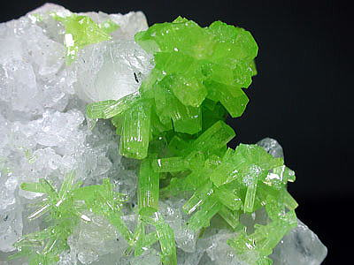
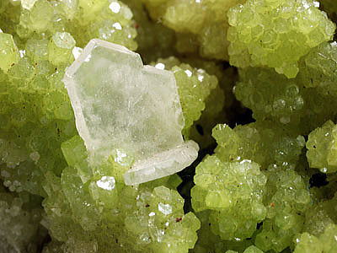
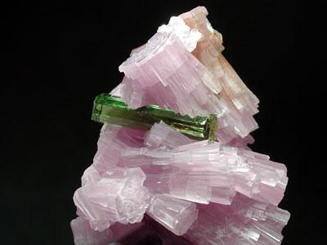
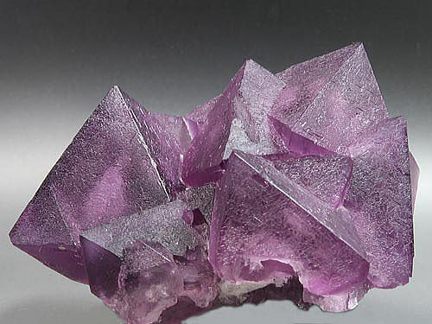
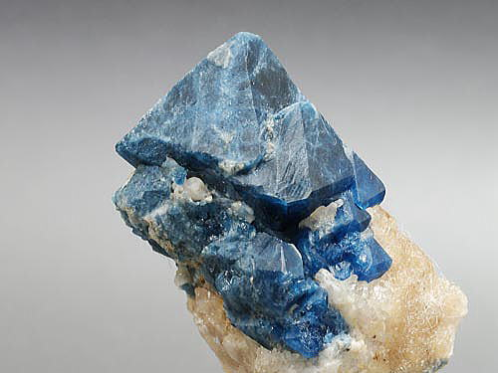
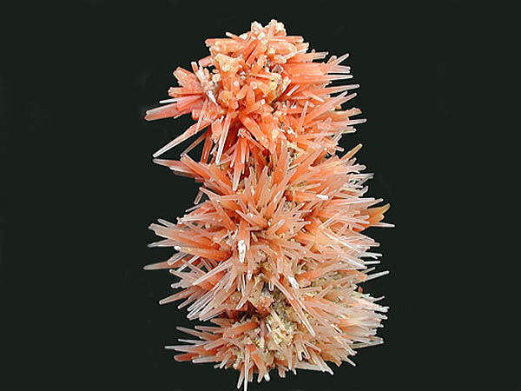
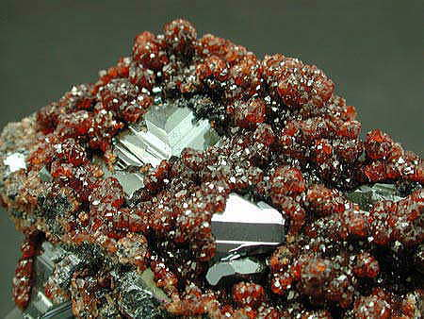
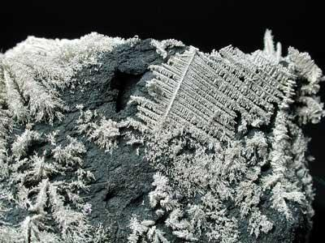
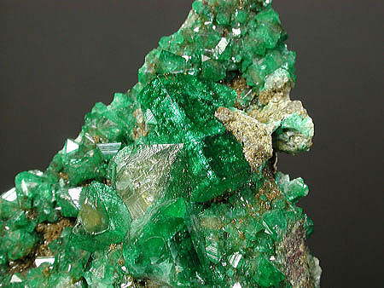
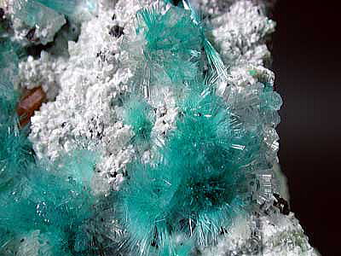
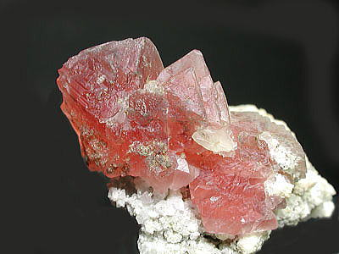
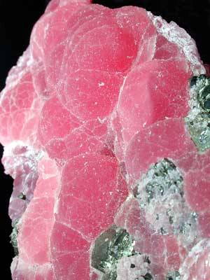
Minerals

Slide 2
What We’ll Be Learning Today…
What is a mineral? What do all minerals have in common?
What is the structure of minerals?
How do minerals form?
How can we identify minerals?
What are the defining characteristics that help distinguish minerals from other things?

Slide 3
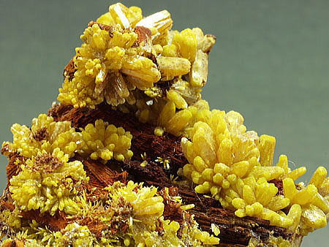
What is a Mineral?
A mineral is a naturally occurring, inorganic solid that has a crystal structure and a definite chemical composition.
Pyromorphite

Slide 4
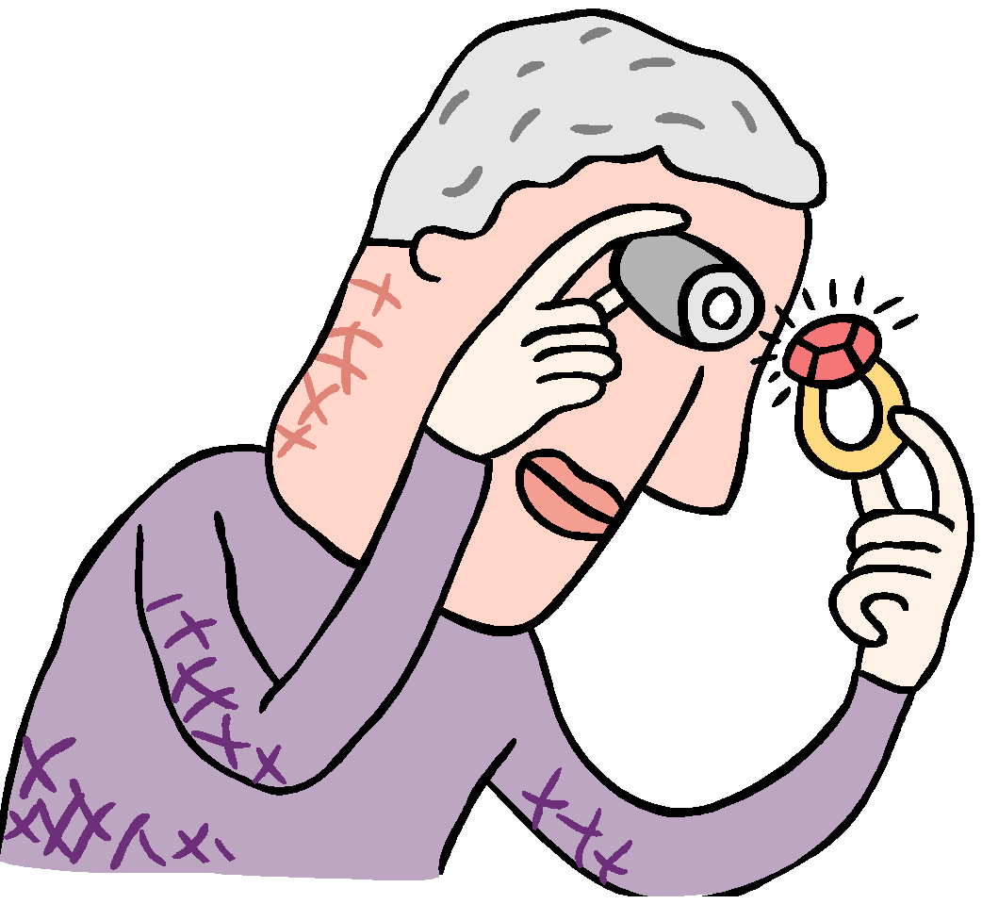
What do all minerals have in common?
    For a substance to be a mineral it must have these 5 properties:
      Formed by natural processes on or inside Earth- no help from humans
      Is inorganic- was never alive. For example, although coal was formed naturally in earth’s crust it came from plants and is therefore, not a mineral
      Is a solid, with definite volume and shape. Liquids cannot be minerals!
      A mineral always contains certain elements that give it a unique chemical composition (makeup). Some minerals are compounds which are made up of more than one element.
      Have a crystalline shape – more on the next slide

Slide 5
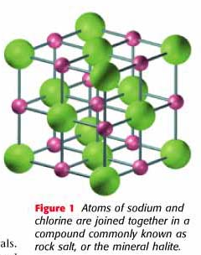
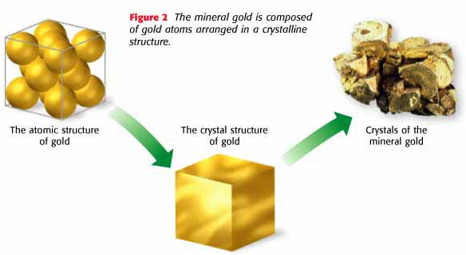
The Structure of Minerals
Have a crystalline shape- the particles of a mineral line up in a pattern that repeats, forming a crystal.
Crystal- solid with atoms arranged in an orderly, repeating pattern

Slide 6
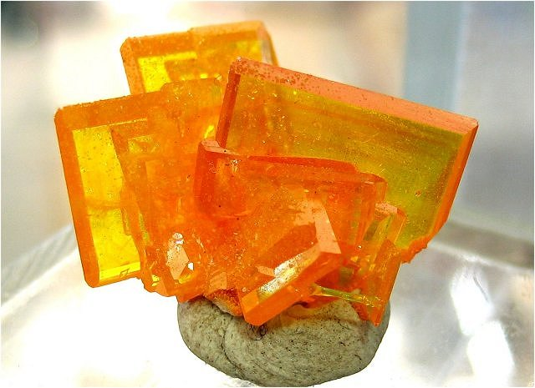
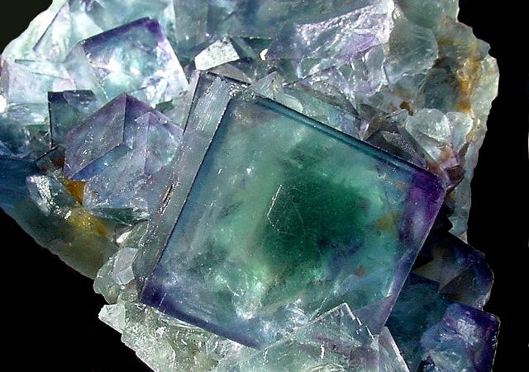
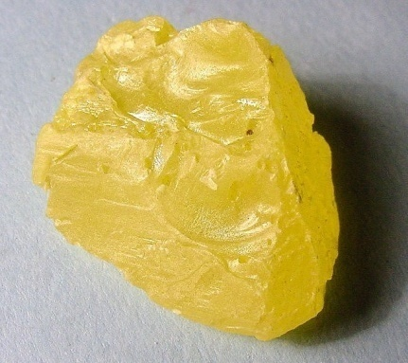
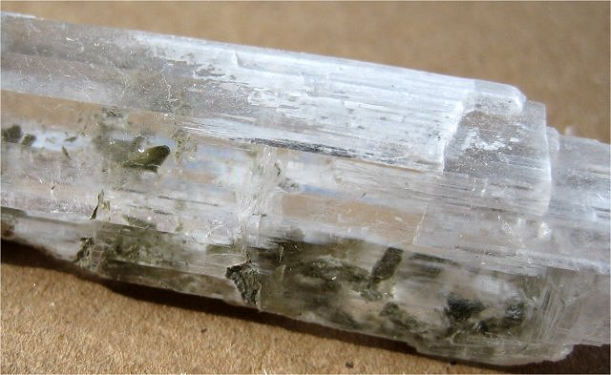
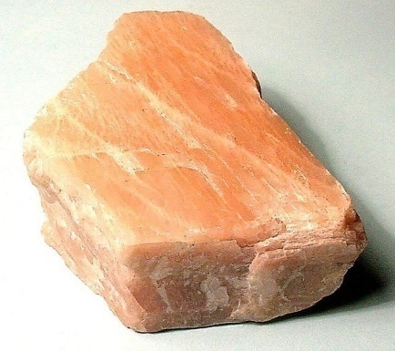
How Will We Identify Today's Minerals?
We look at their characteristic properties
These include:
  Color/Appearance
  Luster
  Streak
  How They Break
  Fluorescence
  Optical Properties
  Magnetism
  Chemical Reactivity

Slide 7
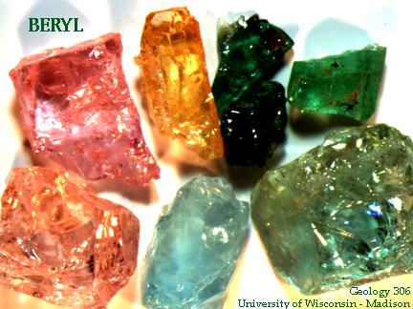
Properties of Minerals
Color
Can be misleading
Many minerals will have a similar appearance but will have different impurities.
Color and appearance are not enough to distinguish minerals.

Slide 8
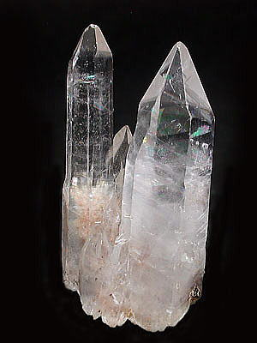
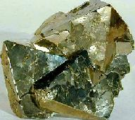
Properties of Minerals
Luster
Luster refers to the way a mineral reflects light from its surface.
Metallic = shiny; attracts light like a metal
Non-metallic = dull, non-shiny surface; does not attract light
We can also use other terms such as waxy, pearly, glassy, dull, silky, milky, greasy, earthy.
Calcite has a non-metallic luster
Pyrite has a metallic luster
Notes:
8

Slide 9
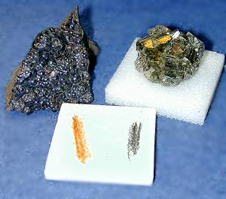
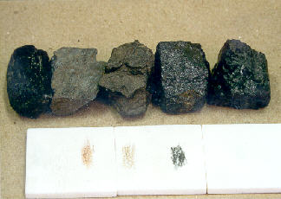
Properties of Minerals
Streak
The color of the powdered form of the mineral.
We find a mineral’s streak by rubbing it on a white ceramic plate (a streak plate).
The color of the streak can be different than the mineral.
Minerals must be softer than the streak plate.

Slide 10
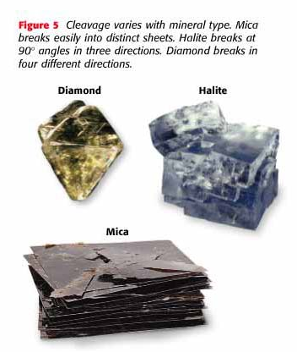
Properties of Minerals
How They Break
  Cleavage—minerals break along smooth, flat surfaces and every fragment has the same general shape.
  Fracture—minerals that break at random with rough or jagged edges.

Slide 11
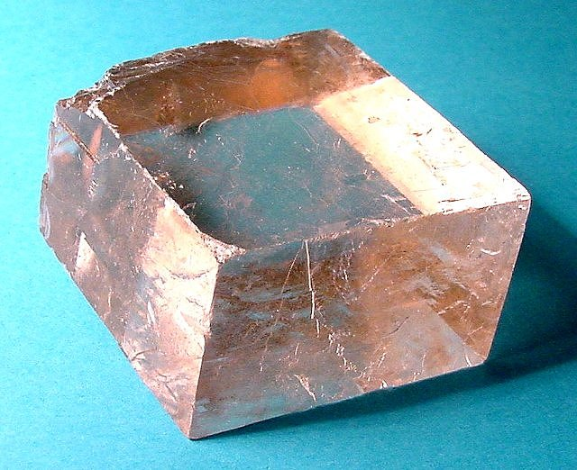
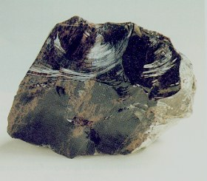
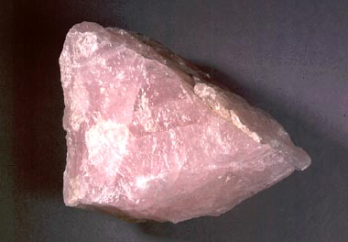
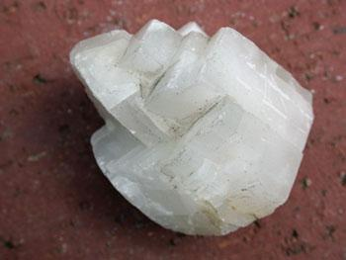
Cleavage or Fracture? Why???
1.
2.
3.
4.

Slide 12
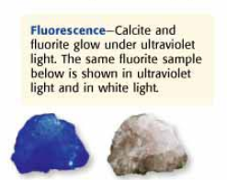
Properties of Minerals
Fluorescence
  The ability of a mineral to absorb energy and glow while or after being exposed to UV light.
  Caused by activators - trace substances inside the mineral whose electrons are spaced just the right distance from their nuclei to absorb UV light and emit it in visible wavelengths.

Slide 13
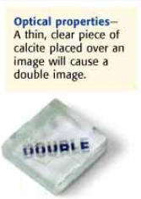
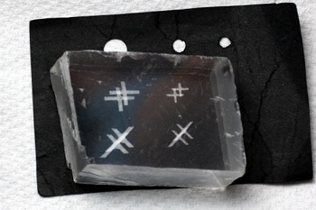
Properties of Minerals
Optical Properties
  How light travels through the mineral.
  Transparent: Clear; light passes right through it.
-Magnification: Makes objects look
bigger than they are.
-Double Refraction: Makes one object
or thing seen through the mineral look
like two. Birefringence
  Translucent: Some light passes through
it, but not completely clear.
  Opaque: No light passes through it.

Slide 14
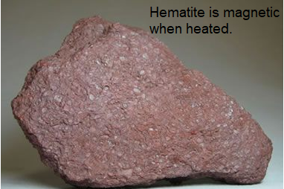
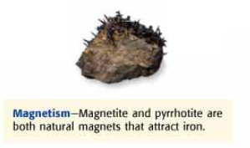
Properties of Minerals
Magnetism
  The force exerted by minerals and rocks when they are passed over a magnetic field.
  Some rocks are magnetic when heated, but others are just naturally magnetic at room temperature.
  Varying amounts of iron present are responsible.

Slide 15
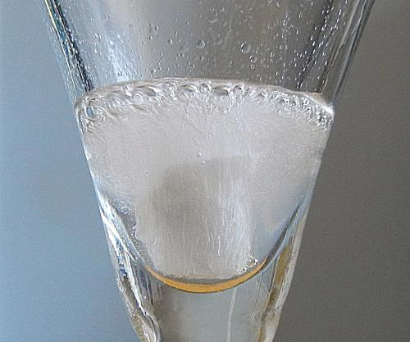
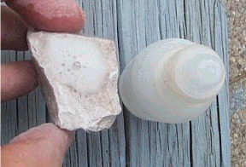
Properties of Minerals
Chemical Reactivity
  The ability of certain minerals to react with different kinds of chemicals.
  Ex: Different types of minerals that contain calcium carbonate will bubble and effervesce when they are exposed to hydrochloric acid or acetic acid (vinegar)
  You will see bubbling, hear fizzing, and see gas or smoke produced off the rock (depending on the strength of the acid). AKA the acid test

Slide 16
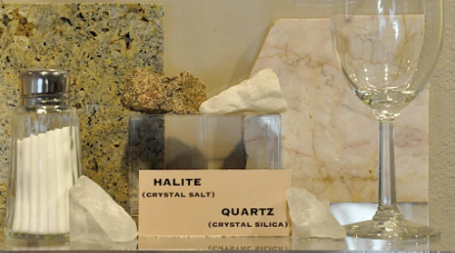
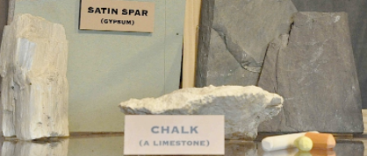
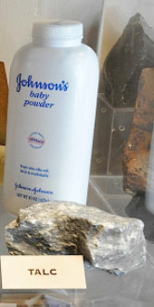

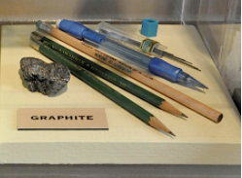
Why Do I Need to Know This???
-Real-Life Connections: Minerals are all around us.

Slide 17
To Sum Things Up….
____________________________________________________________________________________________________________________________________________________________________________________________________________________________________________________________________________________________________________________________________________________________________________________________________________________________________________________________________________________

